Slide 1
Software Quality Engineering
Week 5
Engr. Muhammad Umer Haroon

Slide 2

Use of Mobile (no)
Late coming (no)
Short Attendance (no)
Plagiarism (no)
Cheat (no)
Disrespect (no)

Slide 3
Software Quality (usability of software design)
Windows Vista: One of the most prominent examples of UI design failure is Windows Vista. The operating system was released in 2006 and was met with widespread criticism from users due to its complicated UI. The system requirements were high, and many users found it difficult to navigate the various options and settings.
Healthcare.gov: The launch of Healthcare.gov in 2013 was a disaster due to poor UI design. The website was intended to allow users to enroll in healthcare plans but was riddled with errors, long wait times, and confusing UI. As a result, many users were unable to enroll, and the site became a symbol of government inefficiency.

Slide 4
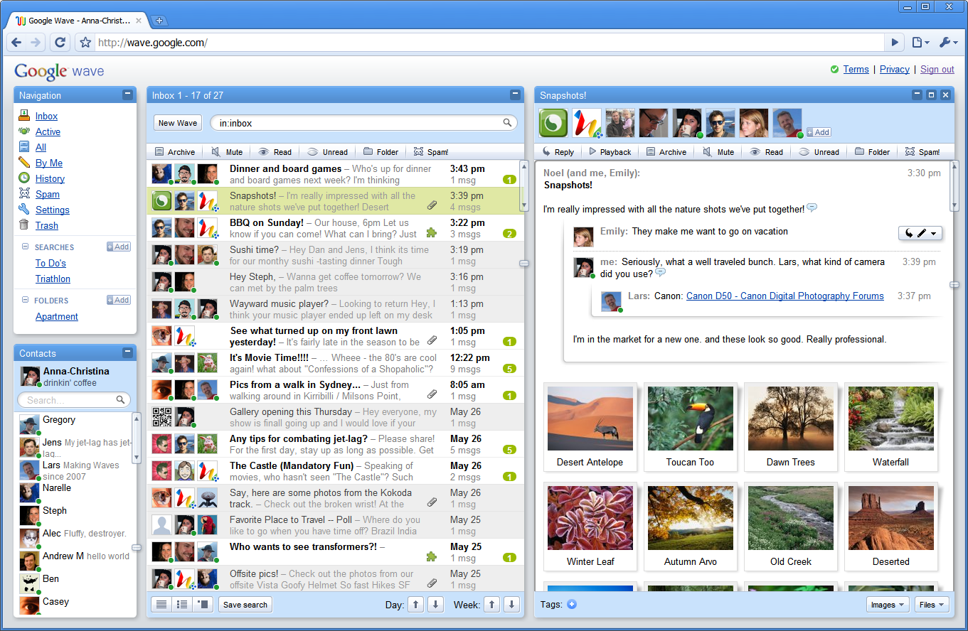

Slide 5
Google Wave: Google Wave was a collaboration platform that aimed to bring together email, chat, and document collaboration in a single interface. However, the platform was confusing for users, and many found it difficult to navigate. The complex UI was a major factor in the platform's failure.

Slide 6
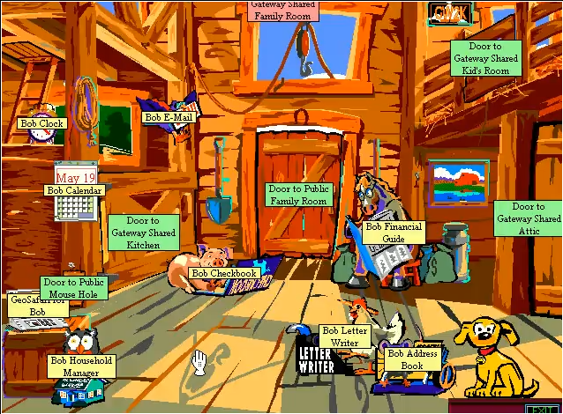

Slide 7
Microsoft Bob: Microsoft Bob was an ambitious project that aimed to create a new, user-friendly interface for Windows. However, the project was a complete failure due to poor UI design. The cartoonish UI was confusing for users, and the software was slow and buggy.

Slide 8
Software Quality (usability of software design)
Paper prototyping
Mockups and wireframes

Slide 9
UI Related Design Heuristics
MARS is a valuable tool for software quality engineers, as it can help to ensure that mobile applications meet high standards of quality and reliability.

Slide 10
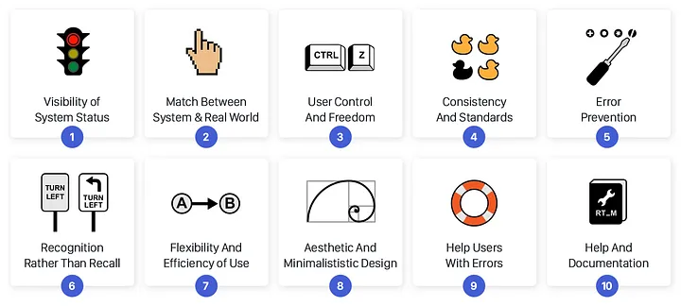
SQE WEEK 5 Heuristic Evaluation Checklist
SQE WEEK 5 Mobile

Slide 11

In the early days of Airbnb, the company's software architecture was relatively simple and straightforward, with a monolithic application that handled all aspects of the user experience. As the company grew, however, this architecture began to strain under the weight of increasing traffic and user demand, leading to slow page load times, frequent downtime, and other quality problems.

Slide 12
Airbnb's software architecture went through a major overhaul in 2015, which involved transitioning from a monolithic architecture to a microservices architecture.

Slide 13
Prior to the overhaul, Airbnb's monolithic architecture was becoming increasingly difficult to maintain and scale, resulting in slow page load times, frequent outages, and a poor user experience. To address these issues, the company decided to adopt a more modern and scalable architecture.

Slide 14
The new microservices architecture involved breaking down the monolithic application into smaller, independent services that could be developed and deployed more easily. Each service was responsible for a specific feature or functionality, and could be updated or replaced without impacting the rest of the system. This made it easier for teams to work independently and iterate more quickly.

Slide 15
The microservices architecture also allowed Airbnb to improve the reliability and availability of its platform. With the monolithic architecture, a single bug or issue could bring down the entire application. With the microservices architecture, individual services could fail without impacting the rest of the system, making the platform more resilient to failures.

Slide 16
Overall, the adoption of a microservices architecture was a major factor in Airbnb's success. It allowed the company to scale its platform more effectively, accelerate development cycles for new features and products, improve the reliability and availability of its platform, and enhance the performance and speed of its website and mobile apps.
Mono (2008-2017)
Micro (2017-2020)
Micro + Macro (2020 onward)
Notes:
https://www.infoq.com/presentations/airbnb-culture-soa/

Slide 17
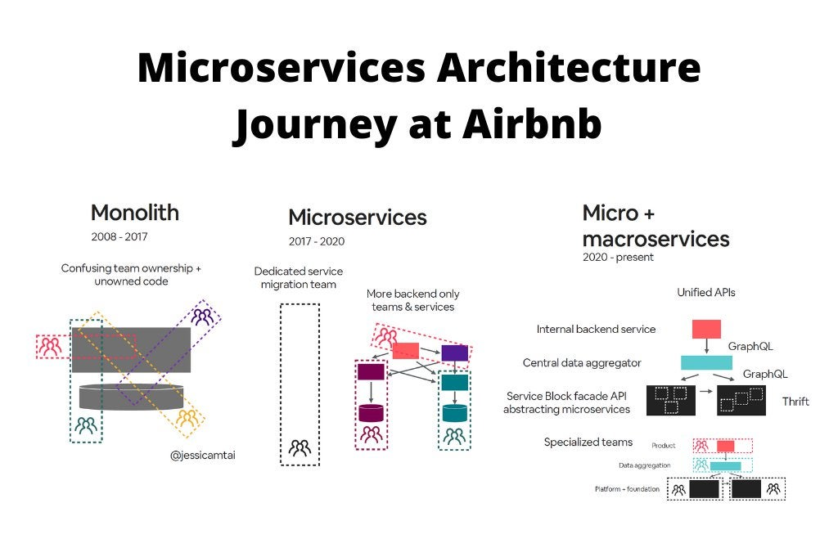

Slide 18
It is a common metaphor that building a software is like building a house.
Commonly architectural styles are associated with two thing , the people who made them or the period in which they were made.

Slide 19
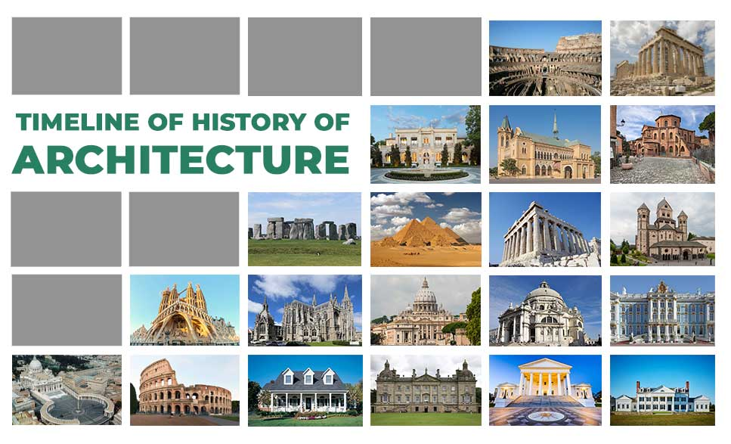

Slide 20
Software Design and Architecture
Software design refers to the process of defining the components, modules, interfaces, and algorithms that make up a software system. This includes the identification of software requirements, the creation of a design that meets those requirements, and the specification of how the software will be implemented. The software design process focuses on the internal details of the software system and how it will be structured to meet the needs of the end-users.
Software architecture, on the other hand, refers to the high-level structure of a software system and how its components and modules will interact with each other to achieve the desired functionality. It defines the overall organization of the system and provides a blueprint for how the different components and modules of the system will work together to meet the software requirements. The software architecture process focuses on the overall structure of the software system and how it will be organized to meet the needs of the end-users.

Slide 21
Examples
In a blogging website, the software design would focus on the components, modules, interfaces, and algorithms needed to implement the functionality of the blog.
This would include the design of the database schema, user interface, comment system, user authentication, and other components that make up the blog. The software design process would also take into account the specific requirements of the blog, such as the ability to publish posts, create tags and categories, search for posts, and manage comments.

Slide 22
On the other hand, the software architecture for the blogging website would focus on the overall organization and structure of the software system. For example, it would define how the user interface component would communicate with the database component to retrieve and store data. It would also define how the comment system would interact with the user authentication component to ensure that only authenticated users can leave comments on the blog.
Overall, the software architecture would provide a blueprint for how the different components of the blogging website would work together to meet the specific requirements of the blog. The software design would then use this blueprint to create detailed specifications for each component and how they will be implemented to achieve the desired functionality.

Slide 23
Imaginative Software design and software architecture of WordPress
Software Design of WordPress: The software design of WordPress includes the following components, modules, interfaces, and algorithms that make up the content management system:
Database schema: WordPress uses a relational database management system to store all of its content, including posts, pages, comments, and user information.
User Interface: WordPress provides a user-friendly interface for creating and editing content, managing the site settings, and customizing the appearance of the site.
Themes: WordPress themes allow site owners to change the look and feel of their site by customizing the design, layout, and functionality.
Plugins: WordPress plugins are add-ons that extend the core functionality of the content management system. They can be used to add features like e-commerce, social media integration, and site optimization.
User management: WordPress provides built-in functionality for managing user accounts, roles, and permissions.
Content management: WordPress provides a comprehensive system for managing content, including the ability to create and edit posts, pages, and other types of content.

Slide 24
Software Architecture of WordPress: The software architecture of WordPress defines the high-level structure of the content management system and how its components and modules will interact with each other to achieve the desired functionality. Some key architectural features of WordPress include:
Core Architecture: WordPress is built on a modular architecture, with a core set of features that can be extended using themes and plugins.
Codebase: WordPress is written primarily in PHP, with a MySQL database backend.
Hooks: WordPress uses a system of hooks and filters to allow plugins and themes to modify the behavior of the core system without changing the codebase.
Template Hierarchy: WordPress uses a template hierarchy to determine how to display content, based on the type of content being displayed and the user's preferences.
Actions and Filters: WordPress uses a system of actions and filters to allow plugins and themes to modify the behavior of the core system without changing the codebase.
REST API: WordPress provides a REST API that allows developers to access content and functionality programmatically.

Slide 25
Software design and software architecture of WhatsApp
Software Design of WhatsApp: The software design of WhatsApp includes the following components, modules, interfaces, and algorithms that make up the messaging application:
User Interface: WhatsApp provides a user-friendly interface for sending and receiving messages, making calls, and managing contacts.
Database schema: WhatsApp uses a relational database management system to store all of the message content, including text, images, and video.
Encryption: WhatsApp uses end-to-end encryption to ensure that all messages are secure and private.
Push Notifications: WhatsApp uses push notifications to alert users to new messages and calls, even when the app is not actively running.
Group Chats: WhatsApp provides a feature for creating and managing group chats, which allows users to communicate with multiple people at once.
File Sharing: WhatsApp allows users to share files, such as photos and documents, with other users.

Slide 26
Software Architecture of WhatsApp: The software architecture of WhatsApp defines the high-level structure of the messaging application and how its components and modules will interact with each other to achieve the desired functionality. Some key architectural features of WhatsApp include:
Client-Server Architecture: WhatsApp uses a client-server architecture, with a central server that manages user accounts and message delivery.
Mobile-first design: WhatsApp was designed as a mobile-first application, with a focus on providing a simple, intuitive user experience on smartphones.
Cross-platform compatibility: WhatsApp is designed to be compatible with a wide range of mobile devices, including both iOS and Android.
Network protocols: WhatsApp uses standard internet protocols, such as HTTPS and XMPP, to ensure reliable and secure communication between users and servers.
Cloud storage: WhatsApp uses cloud storage to ensure that messages are available across all devices.
Third-party integration: WhatsApp provides APIs and integration options for third-party developers to build custom applications and services on top of the messaging platform.

Slide 27
Software architecture styles
Software architecture styles are high-level design patterns that provide a set of guiding principles for organizing software systems. These styles are commonly used in software engineering to structure and organize the components and modules of a software system.

Slide 28
Pipe and filter
Layered
Monolithic
Microservices
Event based

Slide 29
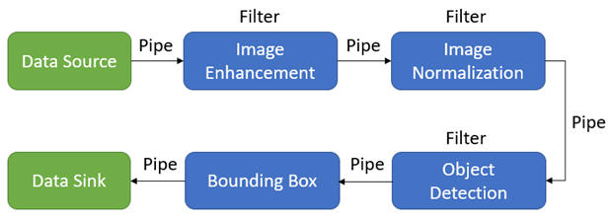
Pipe and filter example
Pipe and Filter is a software architecture pattern in which data flows through a series of components called filters via a communication channel called a pipe. Each filter processes the data and passes it along to the next filter in the pipeline.
For example, consider a video editing software that allows users to apply various effects to their videos. The software might use a pipe and filter architecture to process the video data in the following way:
The video data is first read from a file and passed through a "video decoding" filter, which extracts the raw video frames from the file.
The video frames are then passed through a series of "video processing" filters that manipulate the frames, such as color correction, sharpening, or blurring.
The processed video frames are then passed to a "video encoding" filter, which encodes the frames back into a compressed video format, such as MPEG or H.264.
The resulting encoded video can then be saved back to a file or displayed on the user's screen.
Each of these filters is a self-contained component that receives input data from the previous filter, processes it in some way, and passes it on to the next filter. This approach allows for a modular and flexible design, where different filters can be added, removed, or modified as needed, without affecting the rest of the pipeline. It also enables parallel processing, where multiple filters can be run simultaneously on different parts of the input data, potentially improving performance.

Slide 30
Reusability, parallelization are very key features of this.
When you have something that fits into the pipe-and-filter architecture it works very well.
However, not everything does and specifically this is about transformational systems.
This is not appropriate for interactive systems or stateful systems like building a word processor or website that's not really how this works.

Slide 31
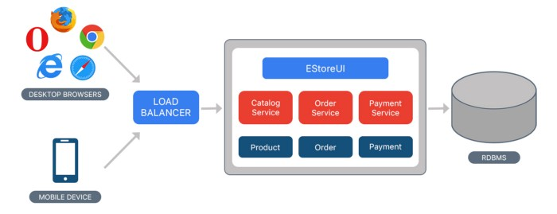
Monolithic
Monolithic software architecture is a traditional design approach where an entire application is developed as a single unit. All modules and components are tightly coupled and run within a single process and database, making the system difficult to scale, modify and maintain. However, monolithic architecture is straightforward to develop and deploy, requiring fewer resources and skills than distributed systems.

Slide 32
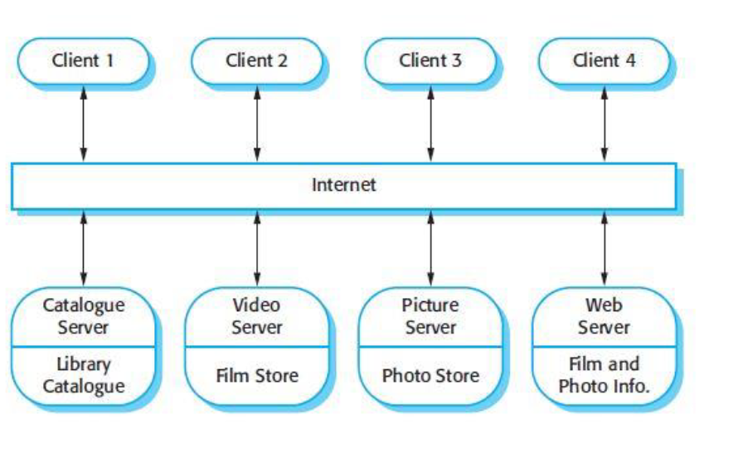
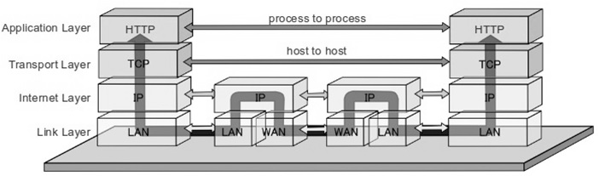
Layered architecture: This style organizes software into a set of layers, where each layer represents a different level of abstraction. This approach can help improve modularity and separation of concerns, making it easier to maintain and modify the software.
Client-server architecture: In this style, the software system is split into two parts: a client application that sends requests to a server, which processes those requests and returns responses. This style is often used in distributed systems and web-based applications.
Microservices architecture: This style decomposes the software system into a collection of small, independent services that can be developed, deployed, and scaled independently. This approach can help improve agility and scalability, but also introduces new challenges related to communication and integration between services.
Event-driven architecture: In this style, the software system is designed around the concept of events, where different components of the system communicate with each other by publishing and subscribing to events. This approach can help improve flexibility and scalability, but can also introduce complexity and performance issues.

Slide 33
Layered architecture: This style organizes software into a set of layers, where each layer represents a different level of abstraction. This approach can help improve modularity and separation of concerns, making it easier to maintain and modify the software.
Client-server architecture: In this style, the software system is split into two parts: a client application that sends requests to a server, which processes those requests and returns responses. This style is often used in distributed systems and web-based applications.
Microservices architecture: This style decomposes the software system into a collection of small, independent services that can be developed, deployed, and scaled independently. This approach can help improve agility and scalability, but also introduces new challenges related to communication and integration between services.
Event-driven architecture: In this style, the software system is designed around the concept of events, where different components of the system communicate with each other by publishing and subscribing to events. This approach can help improve flexibility and scalability, but can also introduce complexity and performance issues.

Slide 34
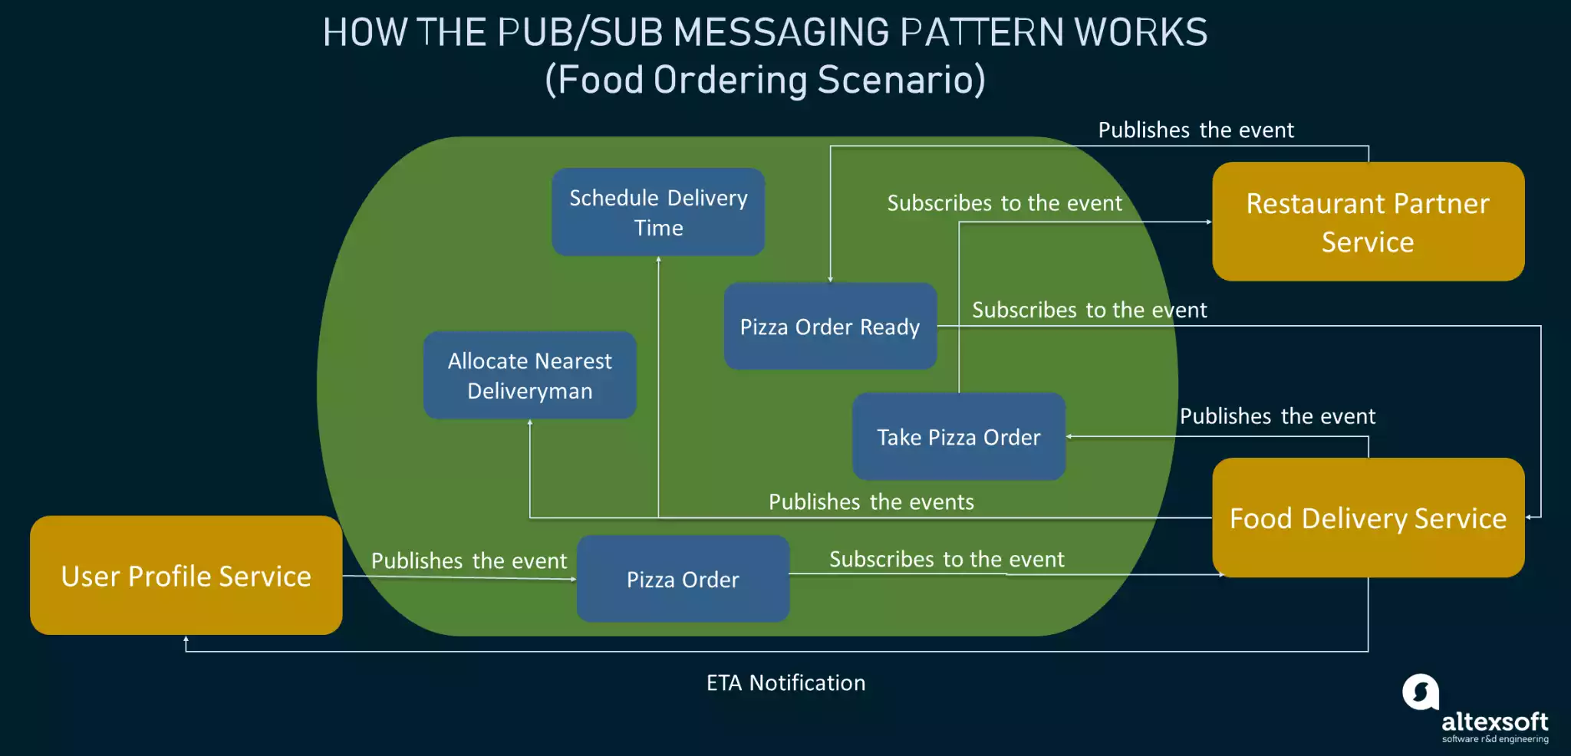
Example event driven
When a user sends a message, the client-side UI generates an event that is sent to the server-side message processing service via an event bus.
The message processing service receives the event, processes the message, and generates another event indicating that a new message has been received.
The client-side UI subscribes to this event and receives the new message, which is displayed to the user in real-time.
Notes:
In software architecture, a service is a unit of functionality that provides a specific set of capabilities or features to other components or services within a larger system. It can be thought of as a modular building block that performs a specific function within a larger application.
Services in software architecture can take many forms, from simple modules that provide basic functionality to complex web services that expose APIs for use by other services or applications. Services can be hosted on a single machine or distributed across multiple machines, and they can communicate with each other using various protocols and message formats.
In a service-oriented architecture (SOA), services are designed to be loosely coupled and independent of each other, allowing for greater flexibility and easier maintenance. Services can be developed, deployed, and managed independently, and changes to one service should not impact other services within the system. This modular approach to software architecture allows for greater scalability, flexibility, and reliability in large-scale systems.

Slide 35
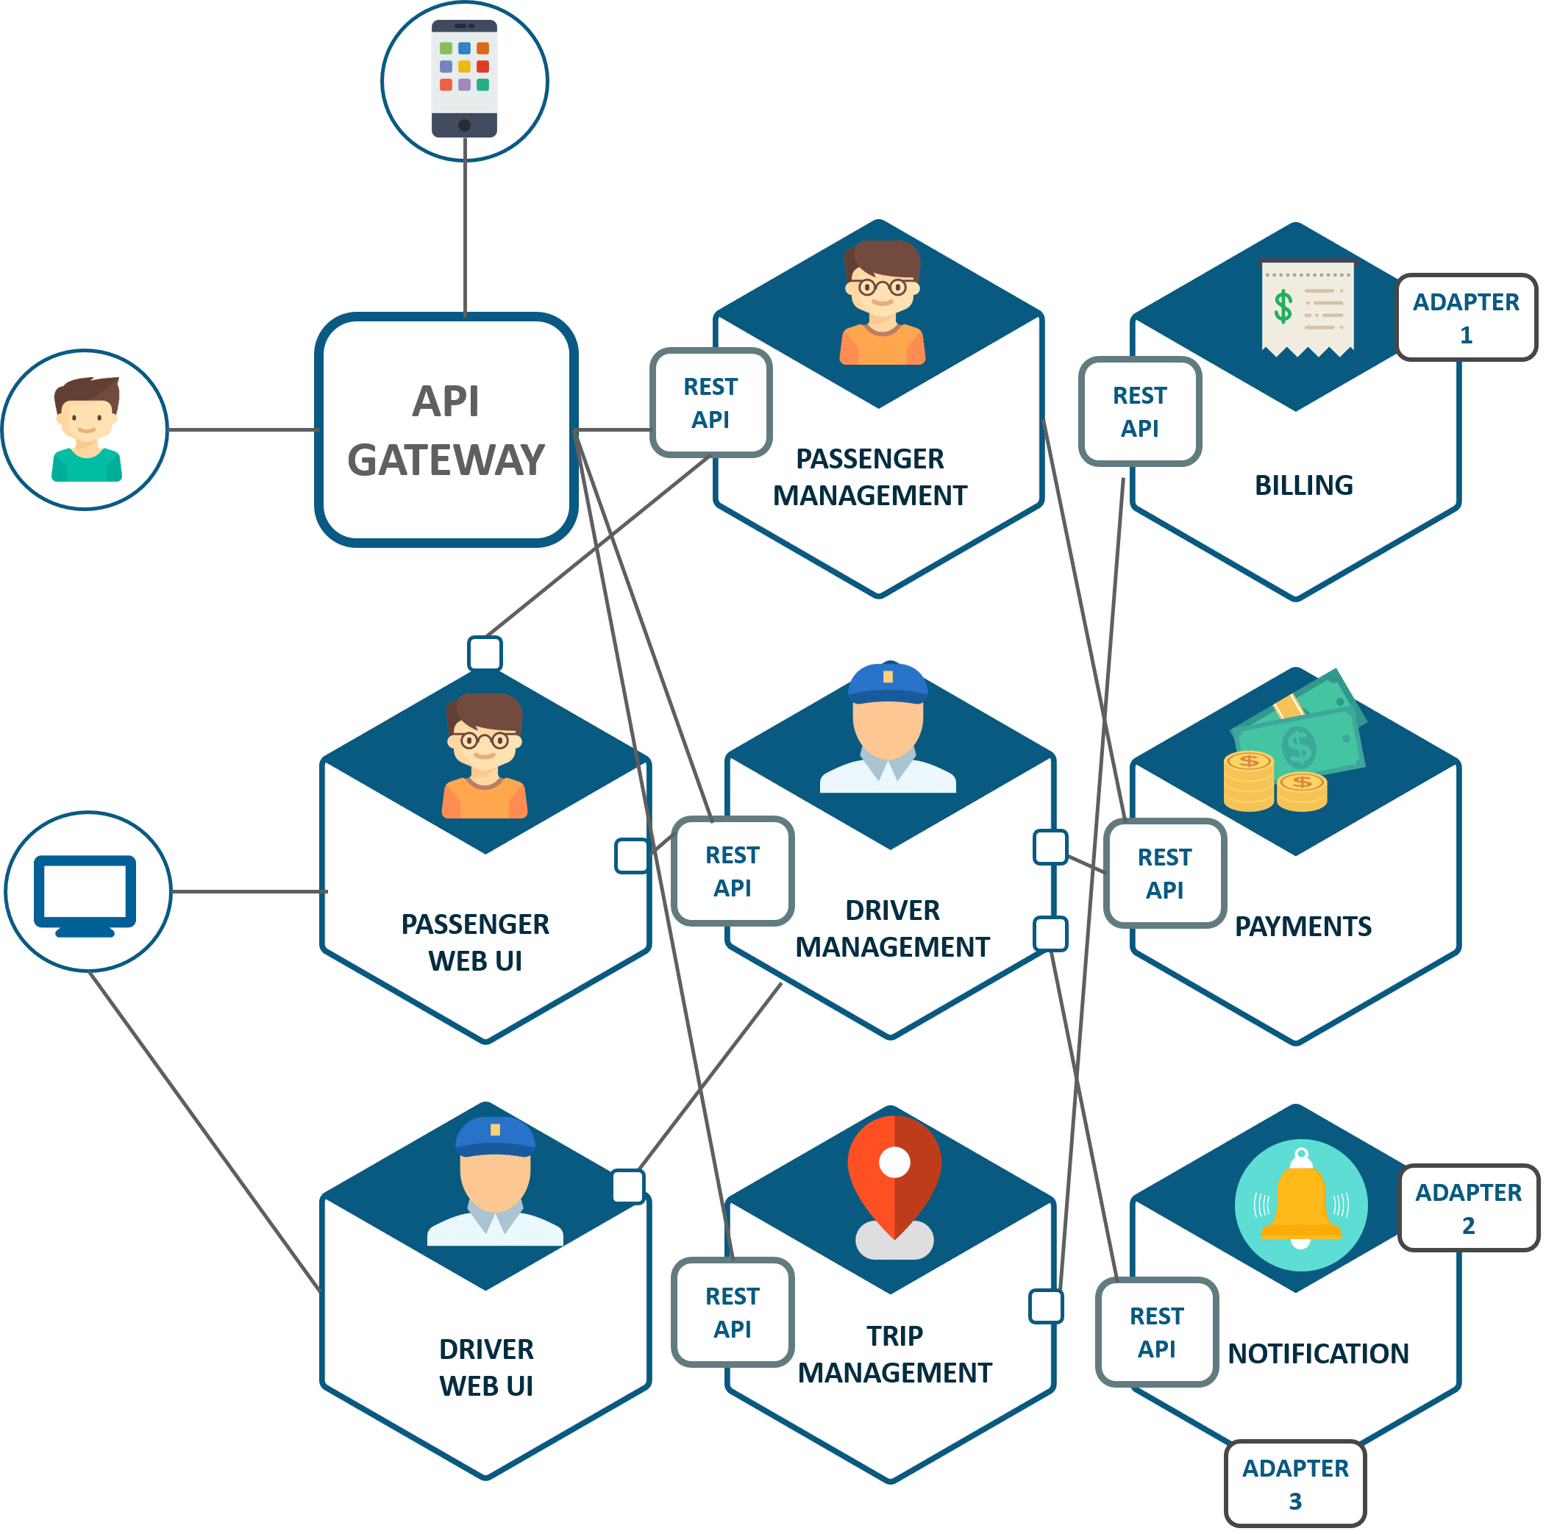
Microservices architecture
Microservices architecture is an approach to software design and development that involves breaking down a large application into a collection of small, independent services that can be developed, deployed, and scaled independently.
Each service is focused on a specific business capability and communicates with other services through lightweight protocols such as REST or messaging.

Slide 36
The choice of which software architectural style to use depends on several factors, including the requirements and constraints of the system, the expected workload, the development team's expertise, and the available infrastructure. Here are some general guidelines that can help with the decision-making process:

Slide 37
Monolithic architecture: This architecture style is well-suited for small to medium-sized applications with relatively simple requirements. It is also appropriate when the application is expected to have a low to medium level of traffic and the development team has expertise in a particular technology stack.

Slide 38
Microservices architecture: This architecture style is appropriate for large and complex applications that require high scalability, availability, and resilience. It is also appropriate when the application is expected to have a high level of traffic and when the development team has expertise in distributed systems, containerization, and DevOps practices.
Best for:
Websites with small components
Corporate data centers with well-defined boundaries
Rapidly developing new businesses and web applications
Development teams that are spread out, often across the globe
Notes:
corporate data centers with well-defined boundaries typically refer to physical or logical boundaries within an organization's computing infrastructure. These boundaries can help to define the scope and responsibilities of different teams or groups within the organization, and can also help to ensure the security and reliability of the organization's computing systems.
In a corporate data center, the boundaries may be physical, such as the walls of a server room or the network perimeter of a data center, or logical, such as virtual private networks (VPNs) or network segmentation.
By defining well-defined boundaries, organizations can help to ensure that their computing infrastructure is secure, reliable, and available. This can help to protect sensitive data and applications, ensure that critical systems are always available, and minimize the impact of any failures or disruptions.
In addition, well-defined boundaries can also help to ensure that different teams or groups within the organization can work effectively and efficiently, by clearly defining their areas of responsibility and the resources they have available. This can help to reduce confusion and duplication of effort, and can also help to improve the overall quality and performance of the organization's computing systems.

Slide 39
Event-driven architecture: This architecture style is appropriate when the application needs to respond to real-time events or when it needs to handle a large volume of data. It is also well-suited for building complex systems that need to be highly decoupled and resilient.
Best for:
Asynchronous systems with asynchronous data flow
Applications where the individual data blocks interact with only a few of the many modules
User interfaces

Slide 40
Layered architecture: This architecture style is appropriate for applications that require a clear separation of concerns and a well-defined structure. It is also appropriate when the application needs to be highly maintainable and testable.
Best for:
New applications that need to be built quickly
Enterprise or business applications that need to mirror traditional IT departments and processes
Teams with inexperienced developers who don’t understand other architectures yet
Applications requiring strict maintainability and testability standards

Slide 41
Pipe and Filter architecture: This architectural style is often used in applications that involve data processing, such as image or video processing, audio processing, or data analysis. It can also be used in data integration scenarios, where data needs to be transformed and manipulated as it moves between systems.

Slide 42
The choice of architectural style can have a significant impact on the quality of the software system being developed. Here are some of the ways that architectural style can affect software quality:

Slide 43
Modularity and maintainability
A well-designed architecture can help improve modularity and separation of concerns in the software system, making it easier to maintain and modify over time.
Architectural styles such as Layered or Microservices can be particularly effective in this regard.

Slide 44
Scalability and performance
Some architectural styles, such as Client-Server and Microservices, are designed to enable scalability and high performance by distributing processing across multiple machines or nodes. This can help ensure that the system can handle increasing loads and remain responsive even under heavy use.

Slide 45
Flexibility and adaptability
Architectural styles such as Event-Driven and Pipe and Filter can be particularly effective in enabling flexibility and adaptability, as they allow different parts of the system to communicate and work together in loosely coupled ways.
This can help ensure that the system can evolve and adapt to changing requirements and circumstances.

Slide 46
Security and reliability
Architectural style can also impact the security and reliability of the software system.
For example, a well-designed Microservices architecture may be more resilient to failures or attacks, as each service can be isolated and secured individually.

Slide 47
User experience
Finally, architectural style can also impact the user experience of the software system. In general the more the distributed the set of tasks are , more convenient it is to focus on user interface to improve usability.
A well-designed User Interface architecture can help ensure that the system is intuitive and easy to use, while a poorly designed architecture can lead to confusing or frustrating user experiences.
Notes:
IBM's User Interface Architecture (UIA) is a software architecture and design framework for developing user interfaces for enterprise software systems. The goal of UIA is to provide a set of principles and best practices for designing and implementing user interfaces that are intuitive, efficient, and user-friendly.
At its core, UIA is based on the principles of user-centered design, which means that the design of the user interface is based on the needs and requirements of the users. This approach involves gathering feedback from users throughout the development process and using this feedback to guide the design of the user interface.

Slide 48
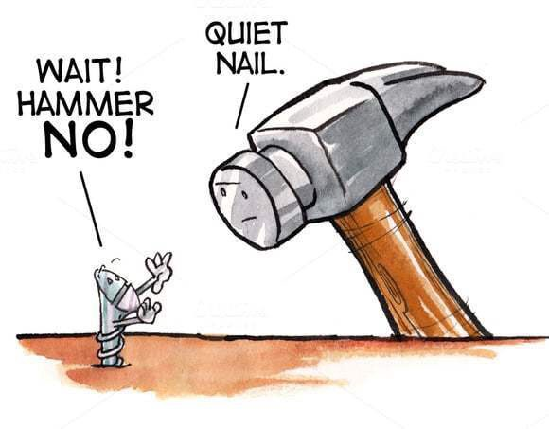

Slide 49
https://www.bredemeyer.com/whatis.htm

Slide 51


